Slide 1
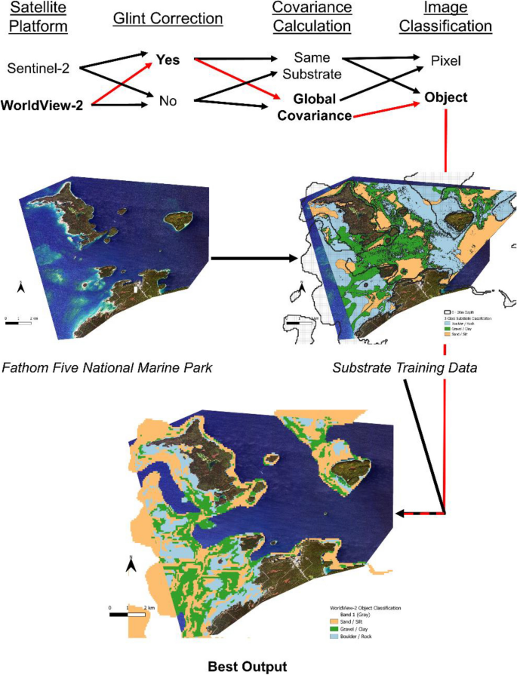
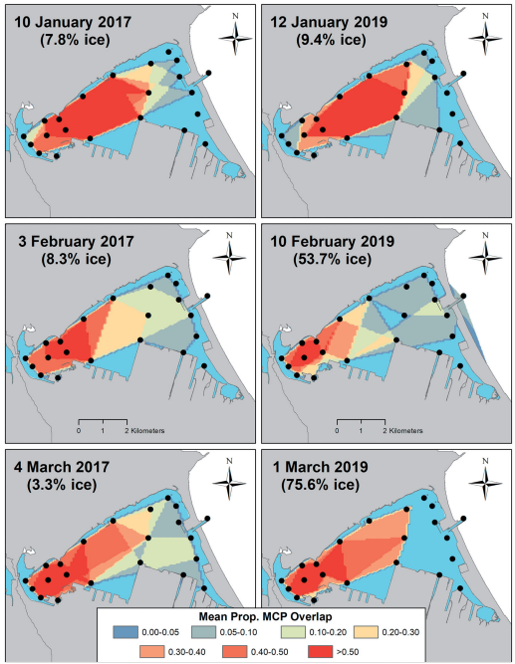
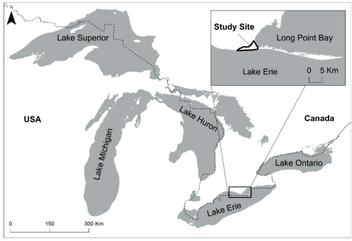
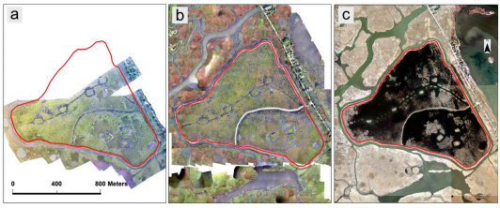
Mapping in R
James Marcaccio
MaDGIC – Bata Library 415

Slide 2
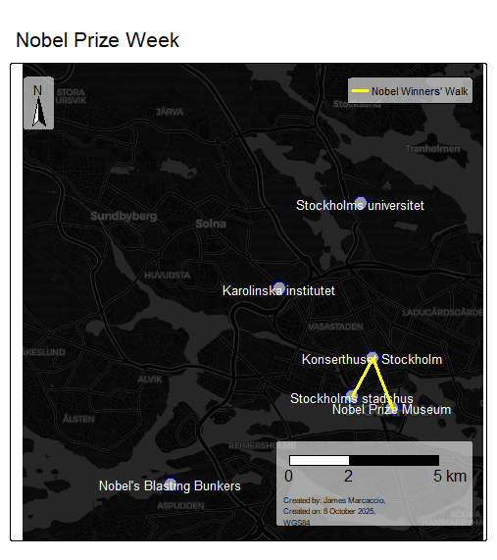
Learning Objectives
Import geospatial data
Plot data on map
Symbolize data
Add map elements

Slide 3

Sharepoint has additional links

Slide 4
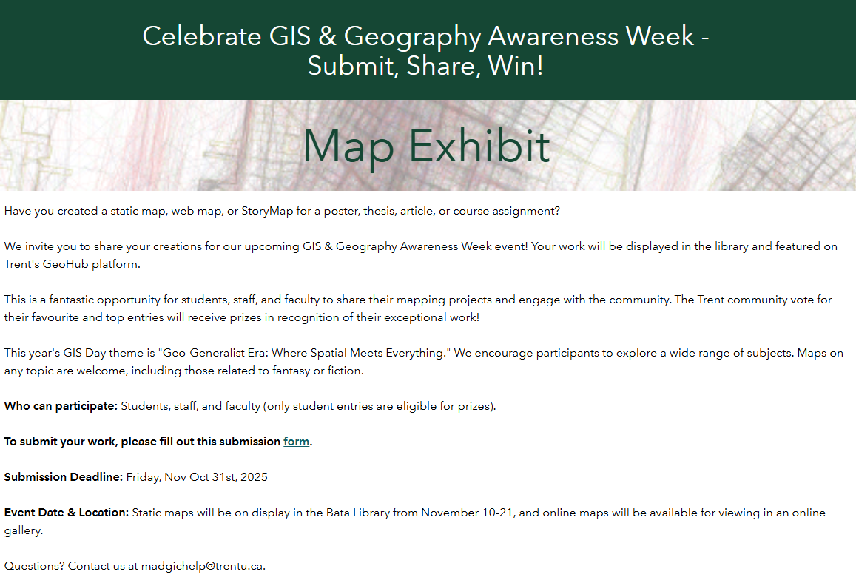
Map Contest! Due October 31

Slide 5
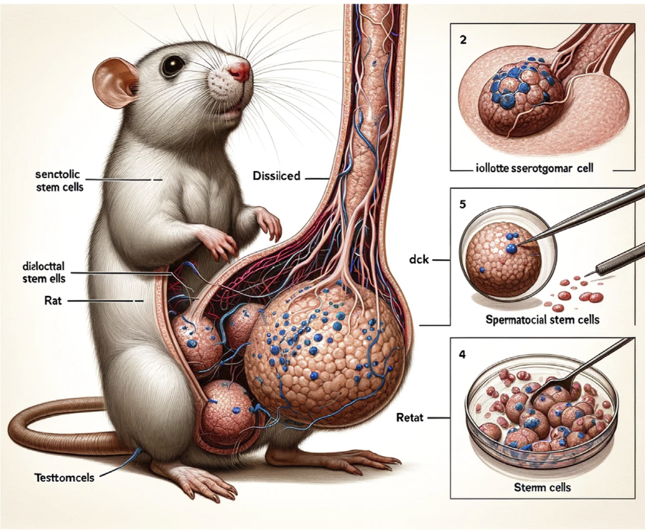


AI Statement
Left: Figure from retracted paper in Frontiers in Cell and Developmental Biology
Below: advertisement for ‘Willy’s Chocolate Experience’
AI used to assist with this workshop
Use copilot through myTrent for secure experience
Struggles with options here
Often presents false variables/statements
Claude (Anthropic) may be better coding option?
^ Copilot prompt: “make an image representing vibe coding”

Slide 6
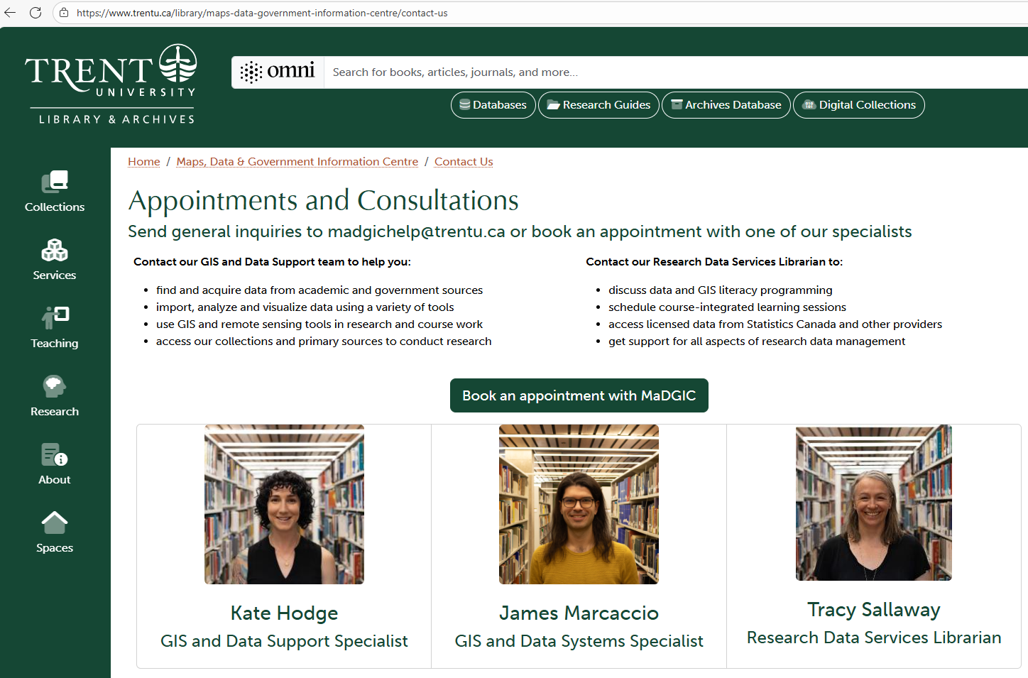
Keep in touch!
madgichelp@trentu.ca

